Slide 2
A Scalable Producer-Consumer Pool Based on Elimination –Diffraction Trees
Clayton Barham & Anthony Dinh

Slide 4
Intro

Slide 5
Intro

Slide 6
Intro

Slide 7
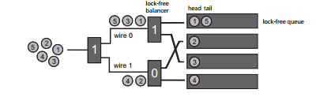
Intro

Slide 8
Intro

Slide 9
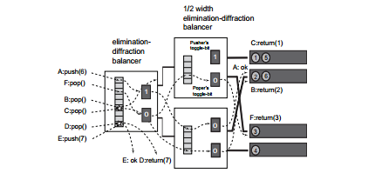
Intro

Slide 10
Implementation

Slide 11
Implementation

Slide 12
Implementation

Slide 13
Implementation

Slide 14
Implementation

Slide 15
Testing

Slide 16
Testing

Slide 17
Testing

Slide 18
Testing

Slide 19
Testing

Slide 20
Questions?

